Slide 1

The Big Fat EA Christmas Quiz

Slide 2

The Rules
No cheating – please do not seek the answers on Google, through Siri, or any other form of technology.
Share the wrong answer – we openly encourage you mess with each other as much as possible. Christmas is a time for fun, but also drama.
Have some fun! ‘Tis the season for weird quizzes like this!

Slide 3
Round One
Christmas in Books

Slide 4
Question
In which literary work does a man dressed as a woman fall in love with a woman dressed as a man at Christmas?
A: The Snowman B: Twelfth Night C: War & Peace

Slide 5
Question
From which town did Dr Seuss’s Grinch steal Christmas from?
A: Whoville B: Wellville C: Whereville

Slide 6
Question
In Harry Potter and the Philosopher’s Stone, what do the Dursleys give Harry for Christmas?
A: an Invisibility Cloak B: a 50p coin C: a list of chores

Slide 7
Question
Which 1846 book tells the story of a little girl selling matches on the cold streets on New Year’s Eve?
A: The Little Girl B: The Little March Girl C: The Little Match Girl

Slide 8
Question
The Lord of the Rings author also wrote The Father Christmas Letters. What was his name?
A: John Ronald Reuel Tolkien B: John Reuel Ronald Tolkien

Slide 9
Round Two
Christmas Movies

Slide 10
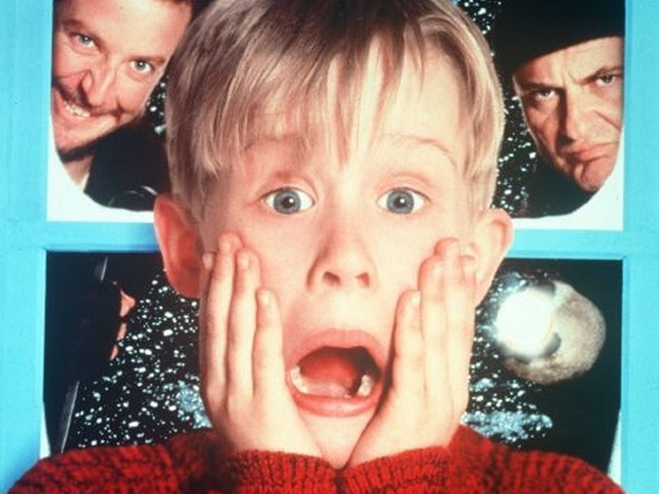
Question: Identify the film
A: The Snowman
B: Harry Potter
C: Love Actually
D: Home Alone

Slide 11
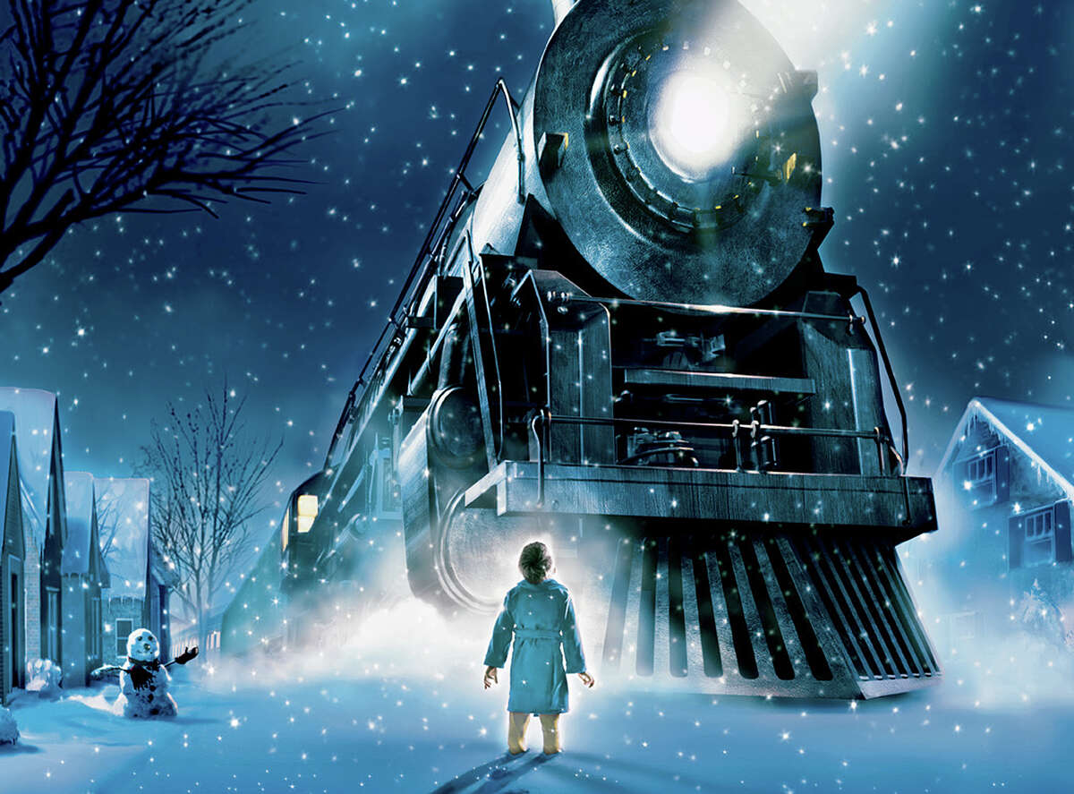
Question: Identify the film
A: Polar Express
B: A Christmas Carol
C: Santa Paws
D: Jack Frost

Slide 12
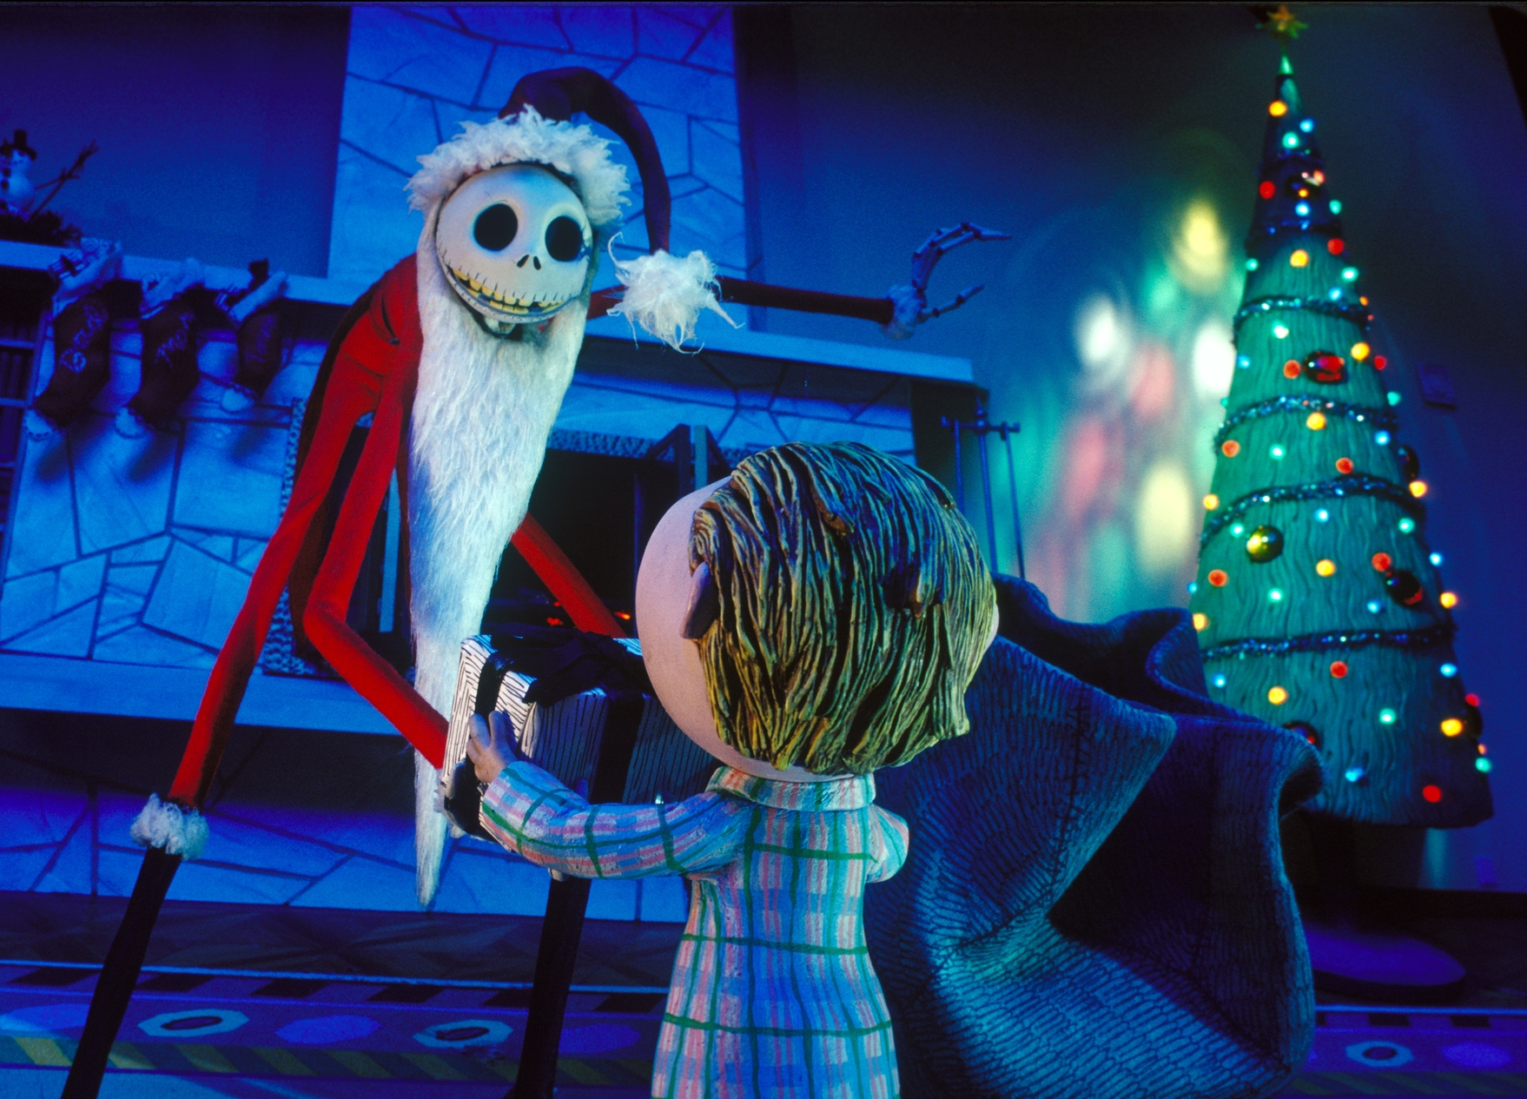
Question: Identify the film
A: Miracle on 34th Street
B: Gremlins
C: The Nightmare Before Christmas
D: Slenderman

Slide 13
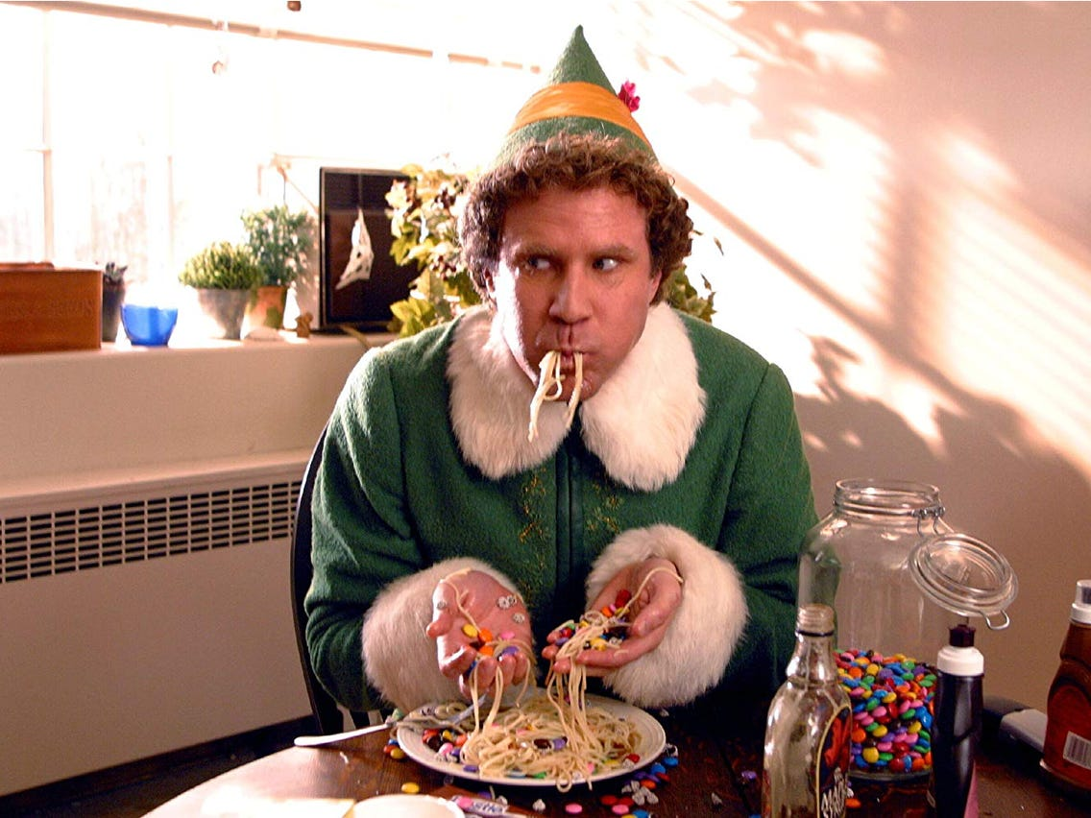
Question: Identify the film
A: A Christmas Carol
B: Last Christmas
C: The Snowman
D: Elf

Slide 14
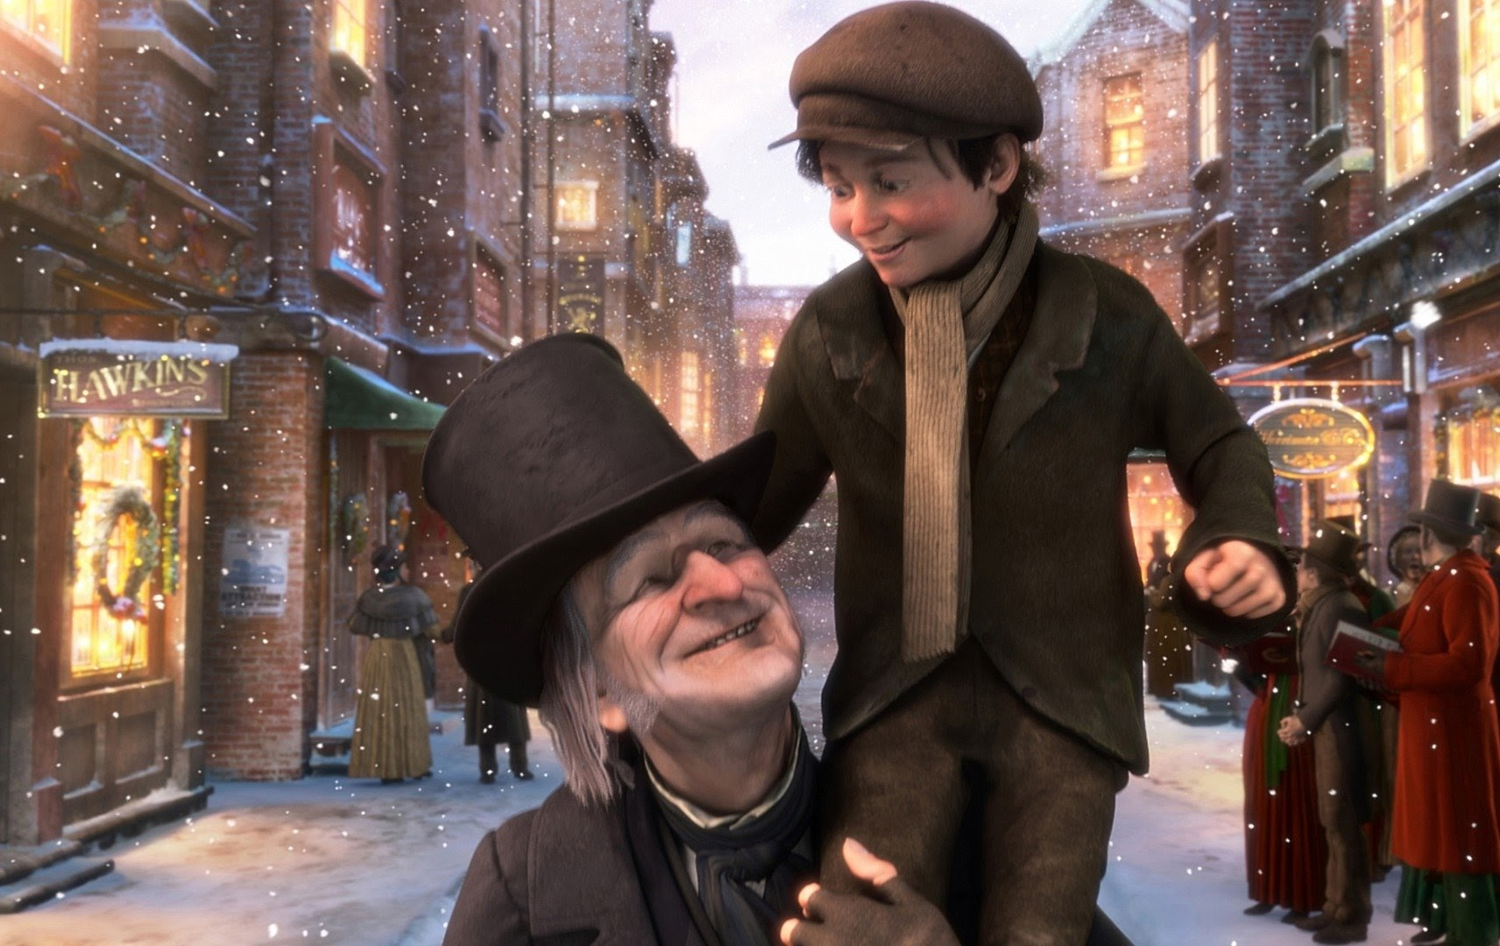
Question: Identify the film
A: Rudolph the Red-Nosed Reindeer
B: A Christmas Carol
C: The Muppet’s Christmas Carol
D: Home Alone

Slide 15
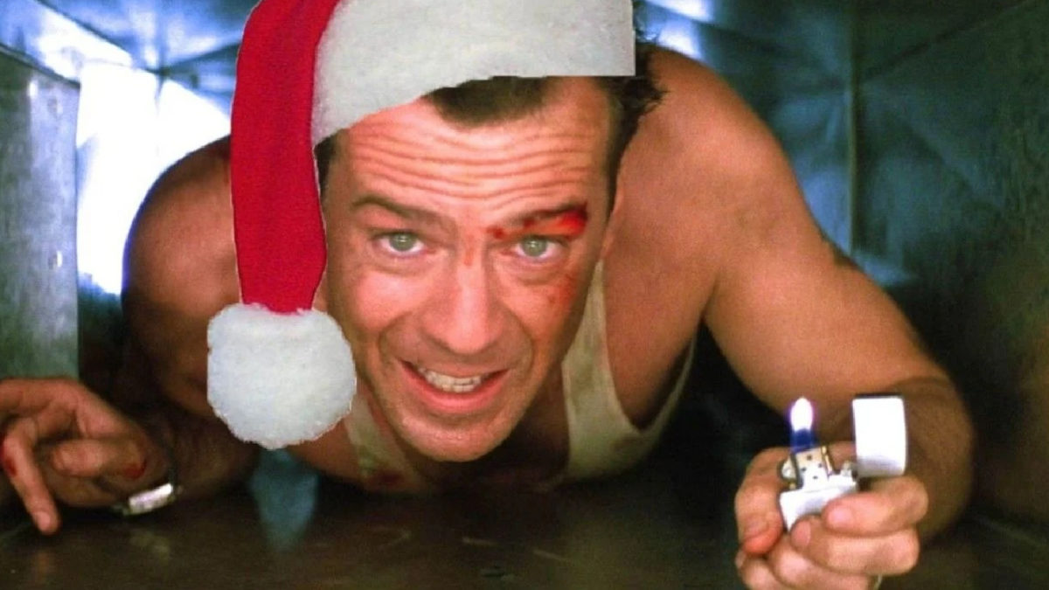
Question: Identify the film
A: Krampus
B: Little Women
C: Die Hard
D: Scrooged

Slide 16
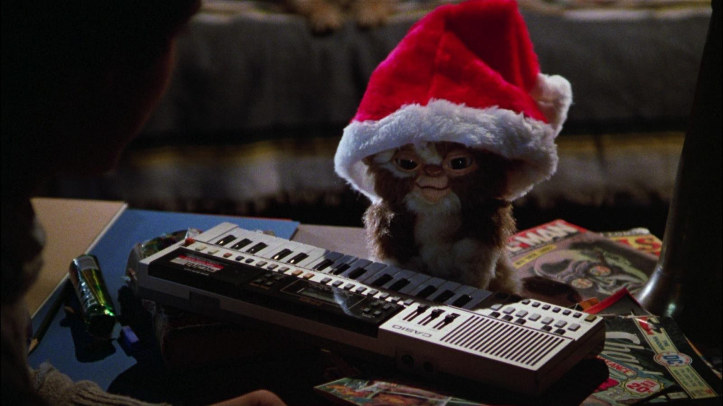
Question: Identify the film
A: Gremlins
B: Falling For Christmas
C: Krampus
D: Jack Frost

Slide 17
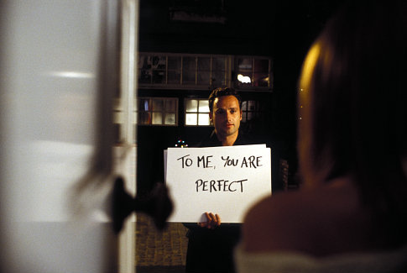
Question: Identify the film
A: Noelle
B: Love Actually
C: The Princess Switch
D: A Christmas Prince

Slide 18

Question: Identify the film
A: Last Christmas
B: Club Tropicana
C: The Princess Switch
D: A Christmas Prince

Slide 19
Round Three
Famous Christmas Songs

Slide 20
Question: Finish the line
All I want for Christmas is ______, baby.

Slide 21
Question: Finish the line
Do they _____ it’s Christmas?

Slide 22
Question: Finish the line
Jingle ____ rock

Slide 23
Question: Finish the line
It’s beginning to ____ like Christmas

Slide 24
Question: Finish the line
________ of New York

Slide 25
Round Four
Christmas Anagrams

Slide 26
Question: unscramble the anagrams
Aleen Moho

Slide 27
Question: unscramble the anagrams
Cod ogres

Slide 28
Question: unscramble the anagrams
Afton hosts mervin

Slide 29
Question: unscramble the anagrams
Abraham chronicle wrists

Slide 30
Question: unscramble the anagrams
Adana tbs

Slide 31
Question: unscramble the anagrams
43 Carleton thermites

Slide 32
Question: unscramble the anagrams
Alister Hirsch scotchmen

Slide 33
Question: unscramble the anagrams
Colly valuate

Slide 34
Question: unscramble the anagrams
Dehlia hoyt

Slide 35
Question: unscramble the anagrams
lef

Slide 36
Round Five
Christmas Facts

Slide 37
Question
Which popular Christmas drink is also called ‘milk punch’?
A: Mulled Wine B: Eggnog C: Snowball

Slide 38
Question
How many ghosts turn up in A Christmas Carol?
A: Nine B: Three C: Four

Slide 39
Question
What do people usually place atop their Christmas trees?
A: An angel B: An elf C: A bauble

Slide 40
Question
Which fairy-tale is the gingerbread house inspired by?
A: Little Red Riding Hood B: Hansel & Gretel C: Sleeping Beauty

Slide 41
Question
What was the first company to use Santa Claus in their advertising?
A: The Guardian B: Coca-Cola C: Apple

Slide 42
Question
How many reindeer does Santa have?
A: Eight B: Ten C: Nine

Slide 43
Question
In the UK, what is usually broadcast in the afternoon on Christmas Day and has done so since 1932?
A: Songs of Praise B: Royal Christmas Message C: The News

Slide 44
Question
Which country started the tradition of putting up a Christmas tree?
A: USA B: Sweden C: Germany

Slide 45
Round Six
Christmas Foods & Drinks

Slide 46
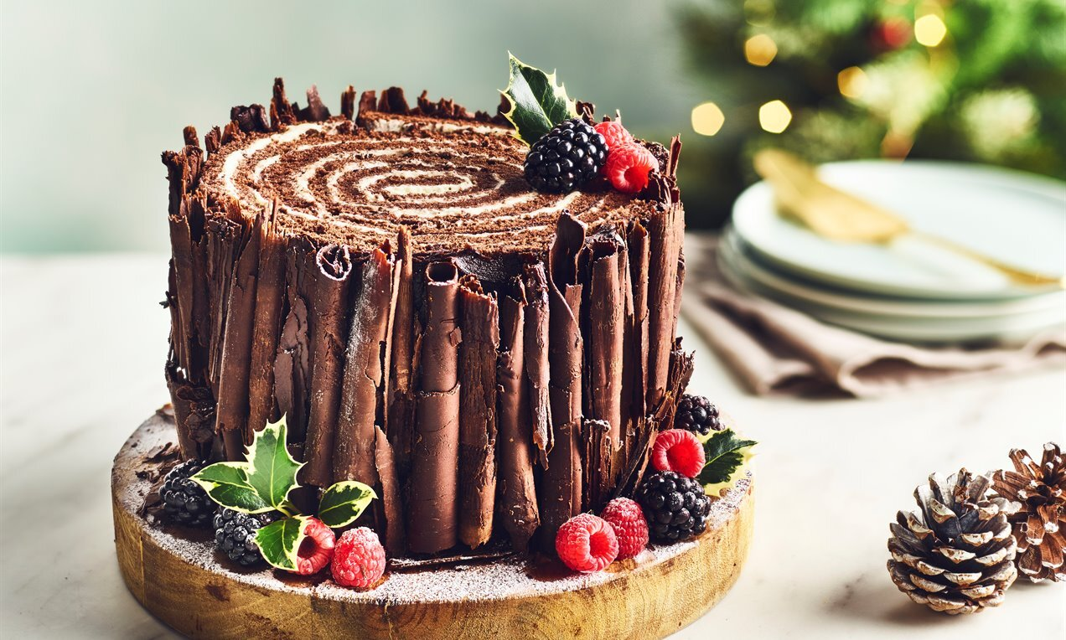
Question identify the food
A: Swiss Roll B: Yule Log C: Cake

Slide 47
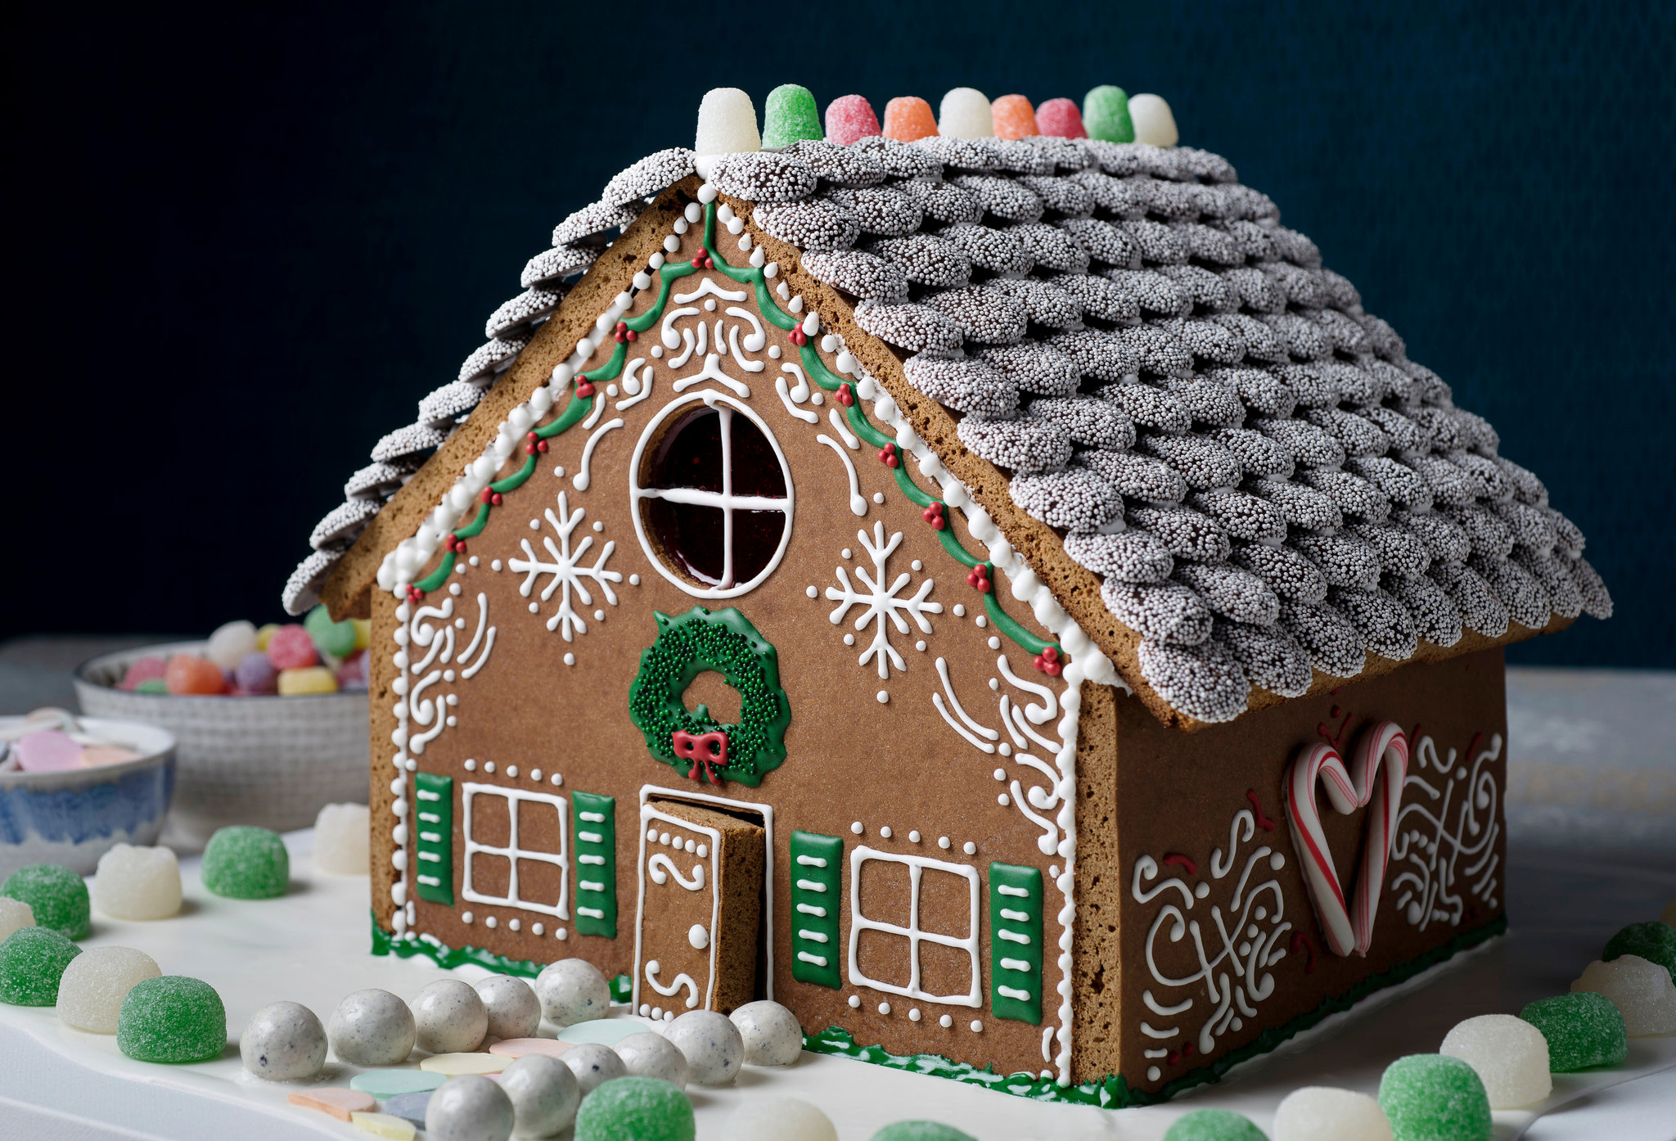
Question identify the food
A: Cookie Cabin B: Gingerbread House C: Swiss Cottage

Slide 48
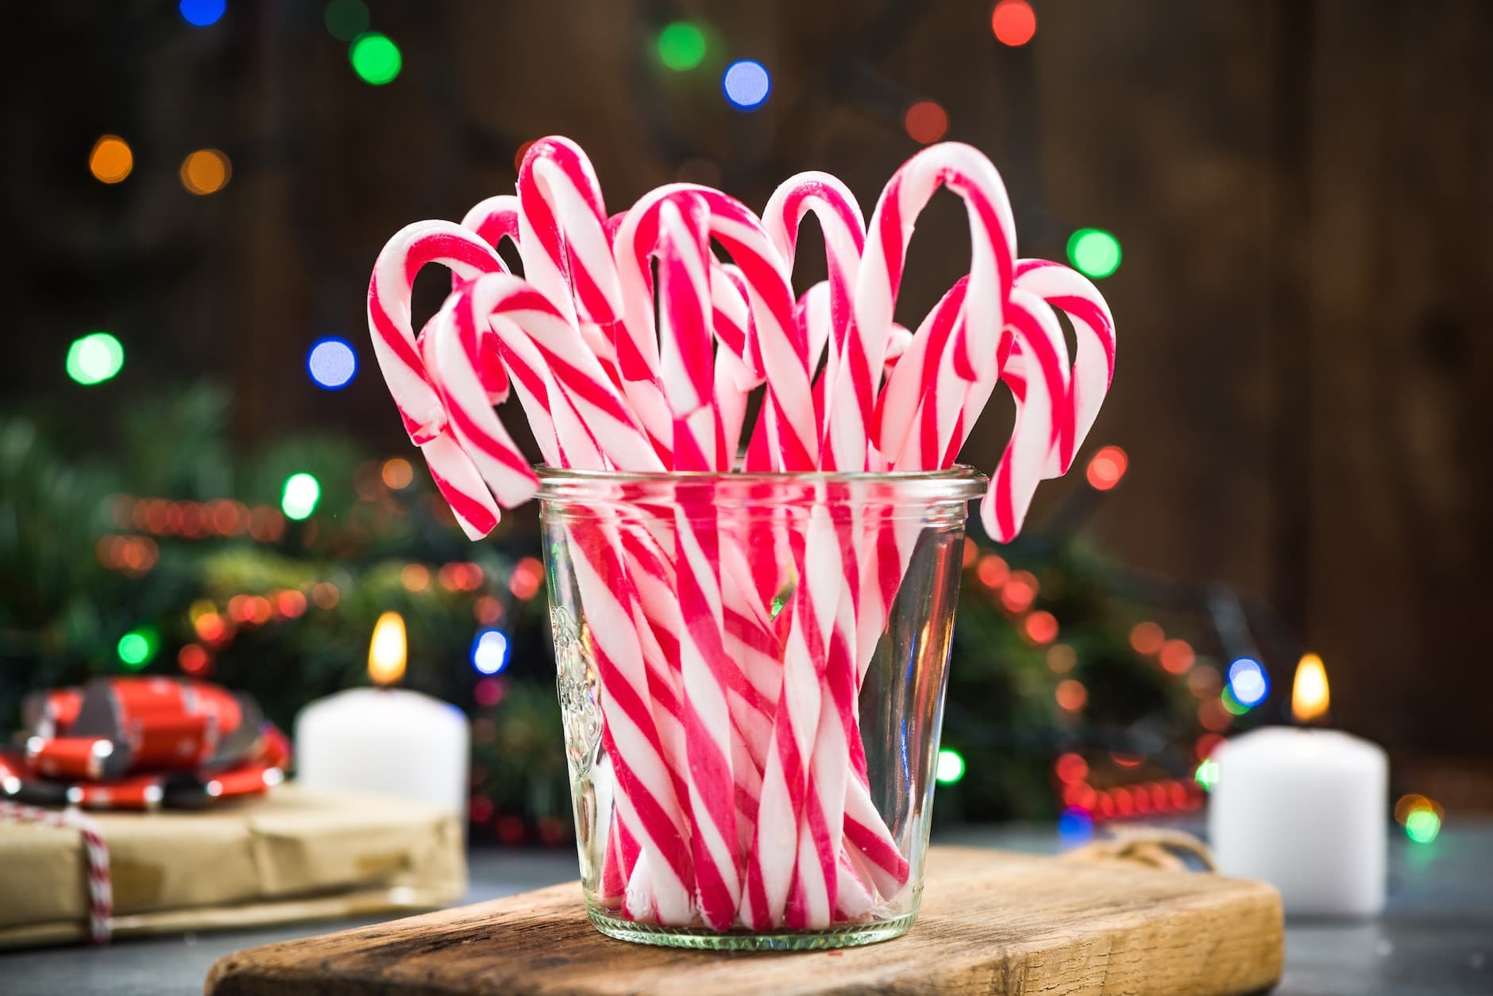
Question identify the food
A: Candy Canes B: Elf Straws C: Mint Sticks

Slide 49
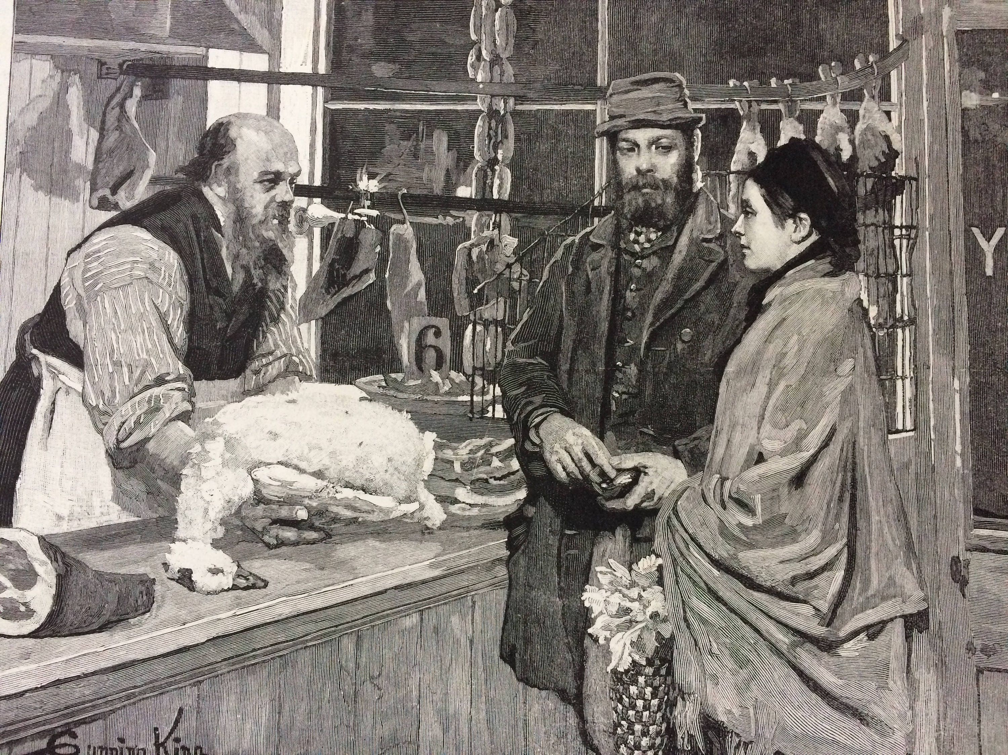
Question identify the food
A: Christmas Duck B: Christmas Turkey C: Christmas Goose

Slide 50
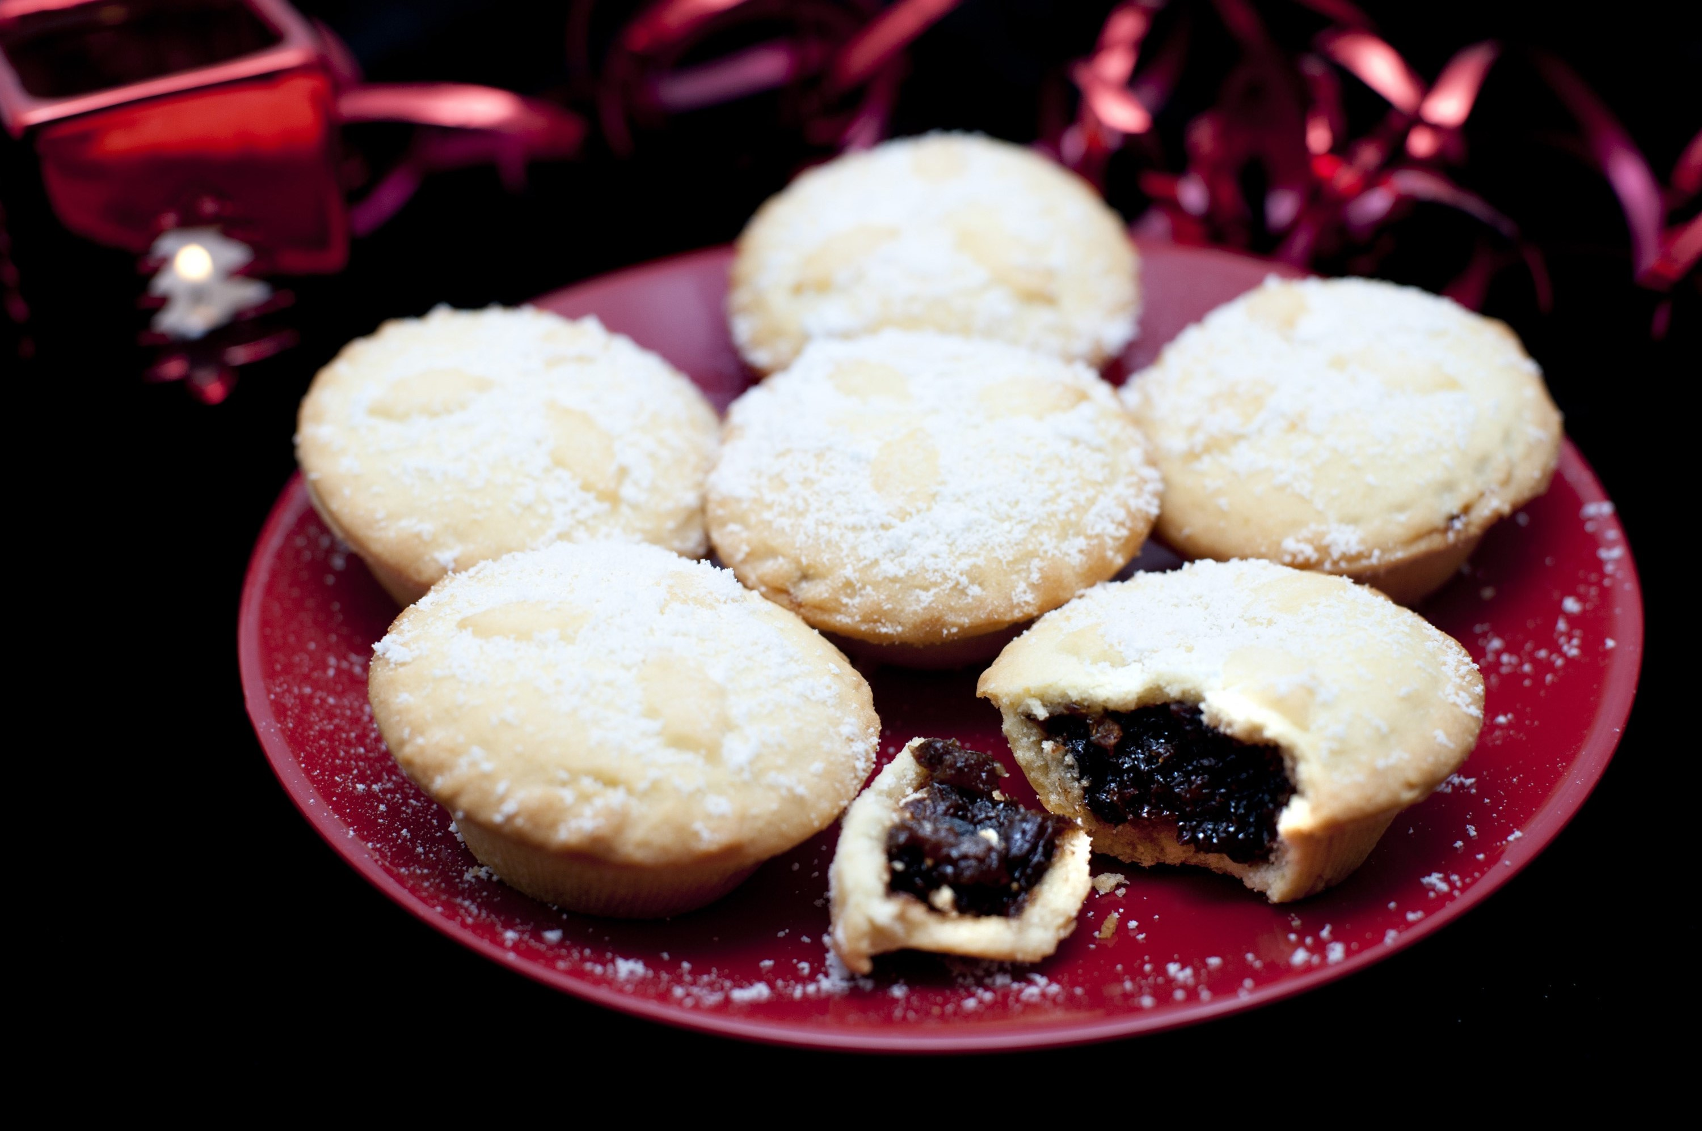
Question identify the food
A: Malt Loaf B: Jam Tarts C: Mince Pies

Slide 51
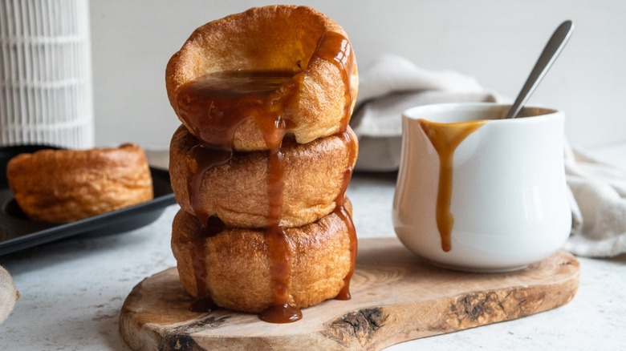
Question identify the food
A: Yorkshire Puddings B: Lancashire Hot Pot C: Cherry Bakewell Tart

Slide 52
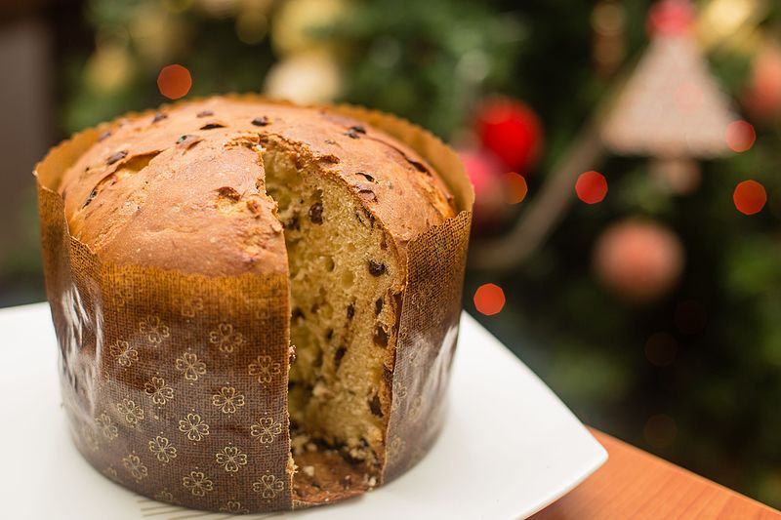
Question identify the food
A: Christmas Cake B: Panettone C: Stollen

Slide 53
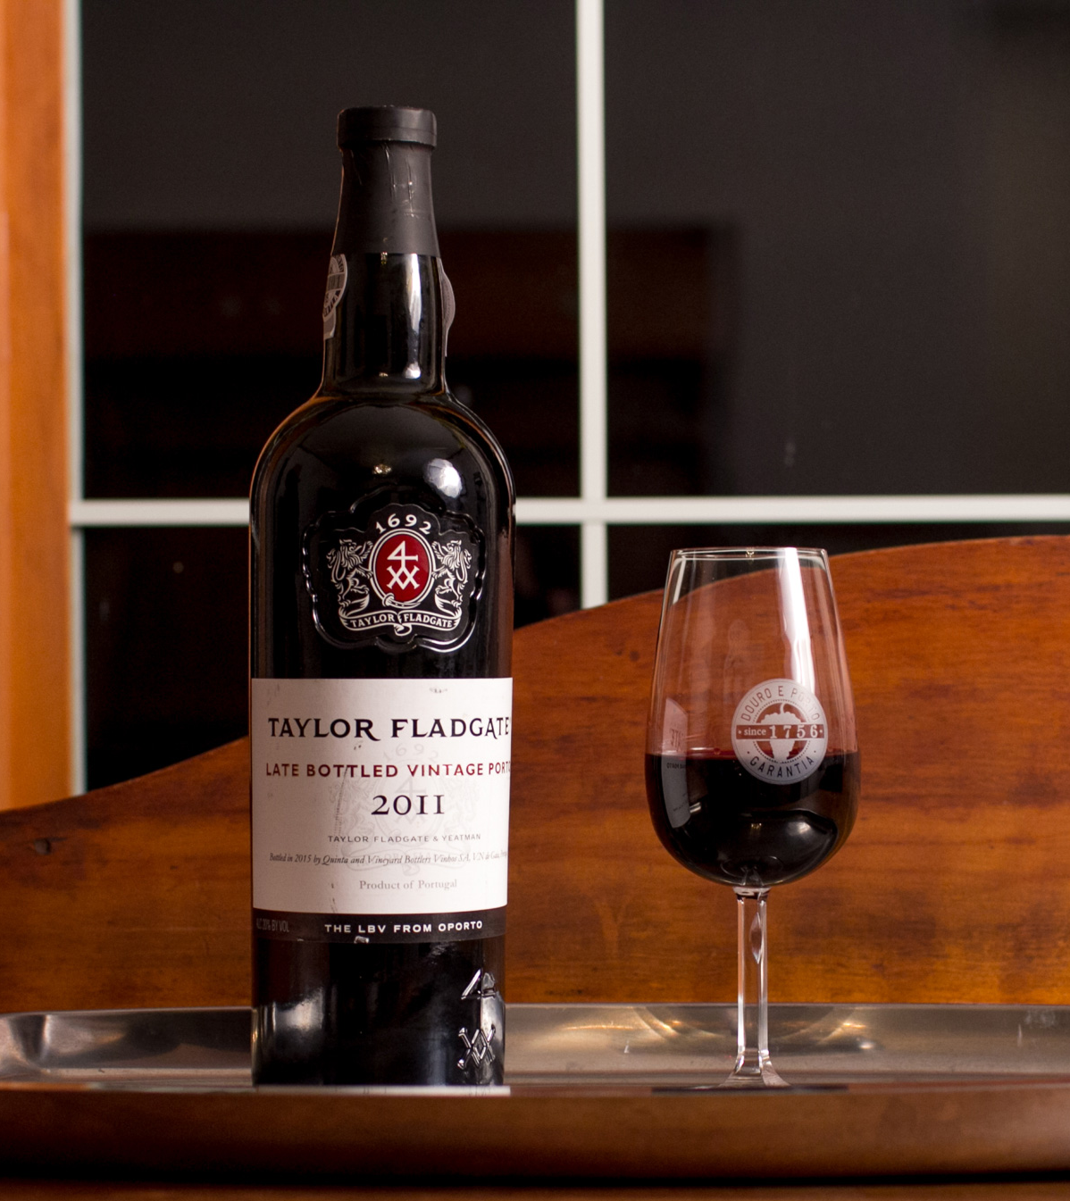
Question identify the drink
A: red wine B: port C: brandy

Slide 54
Alternative resources

